Slide 1

Nitrogen Vacancy Single Point Defects
Adam Blazejczak 1030499

Slide 2
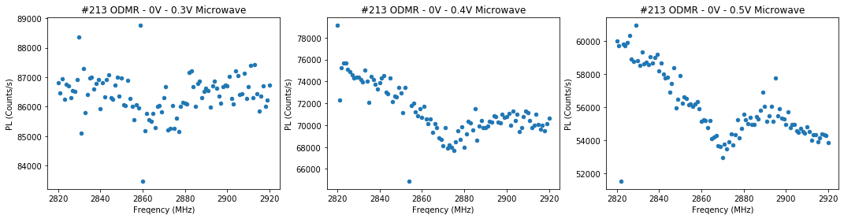
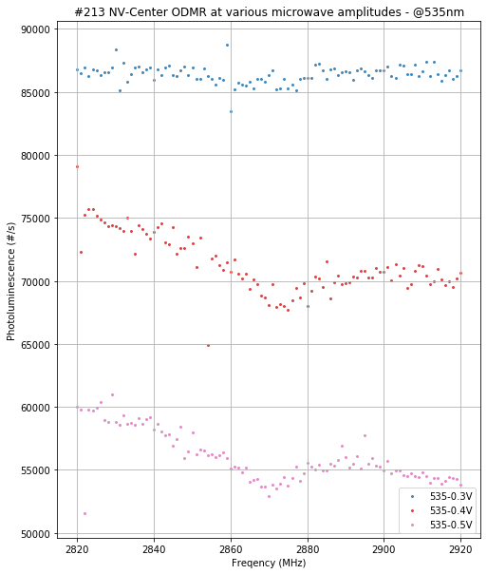
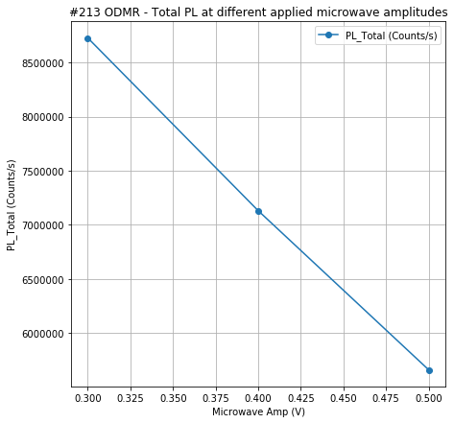

Slide 3
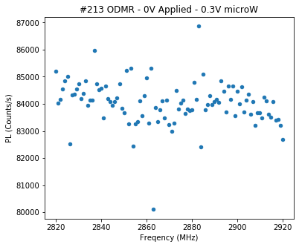
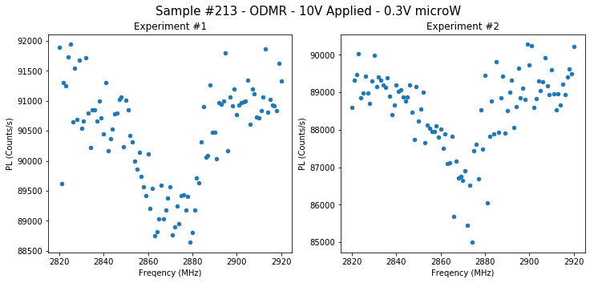
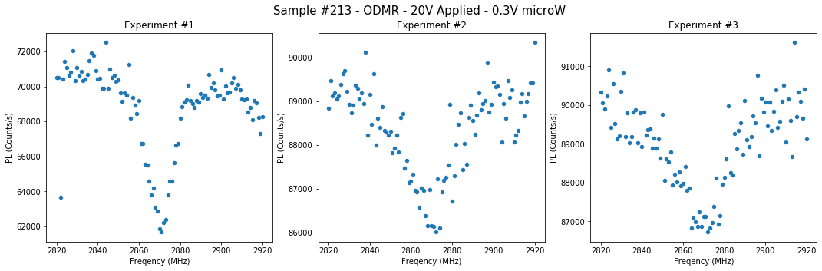

Slide 4
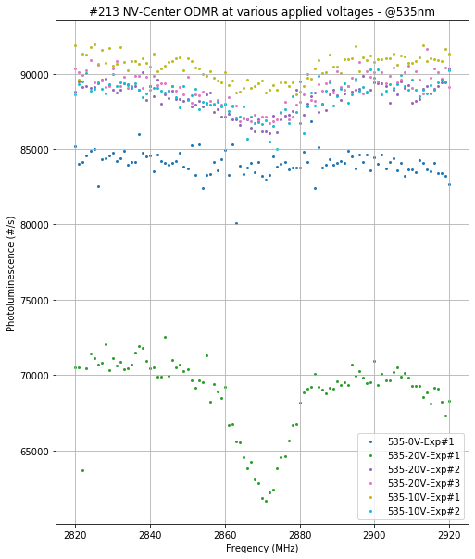

Slide 5
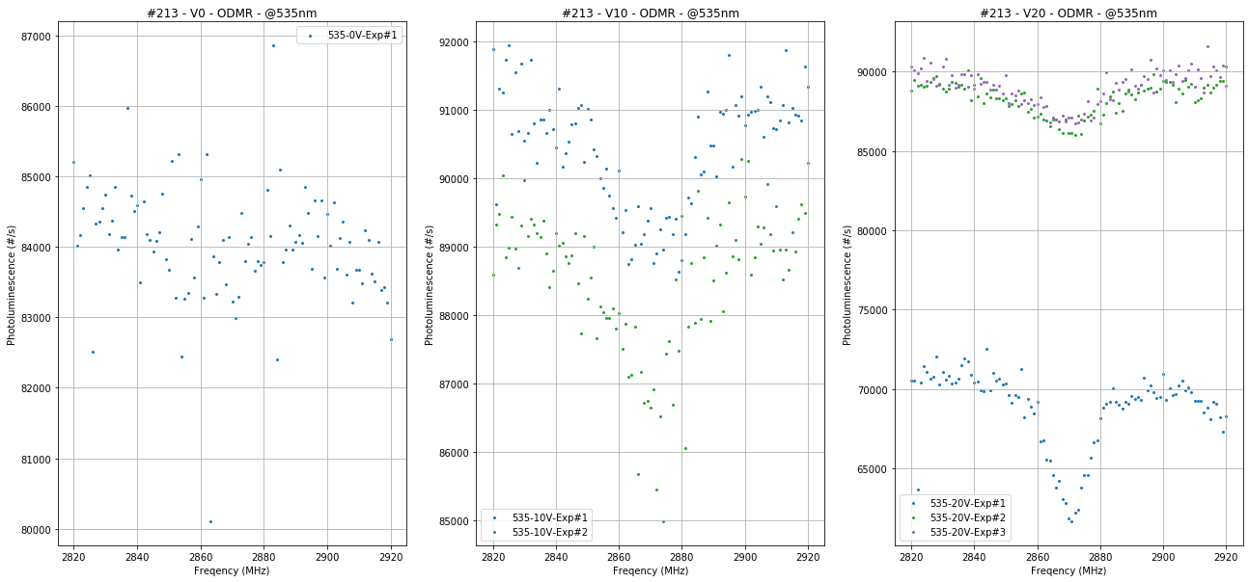

Slide 6
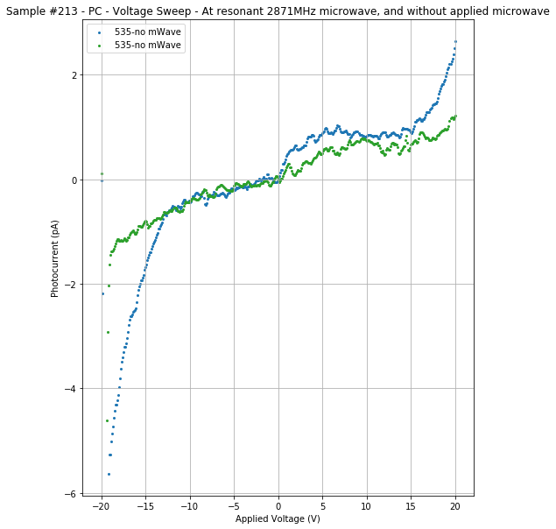
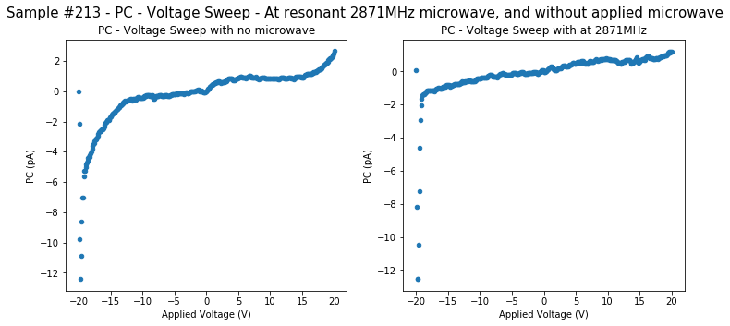

Slide 7
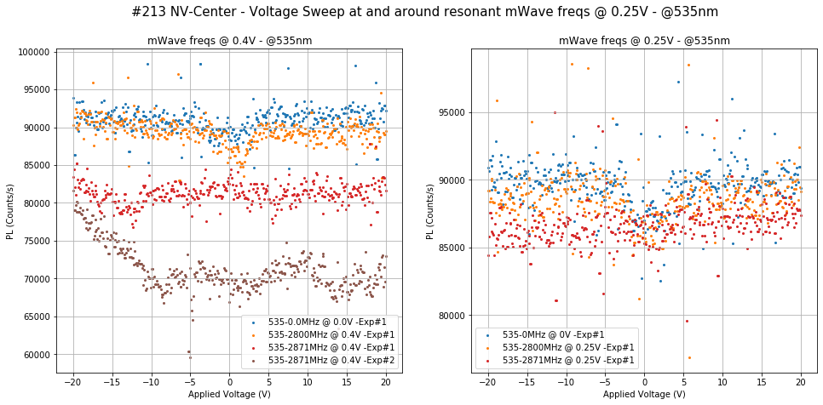

Slide 8
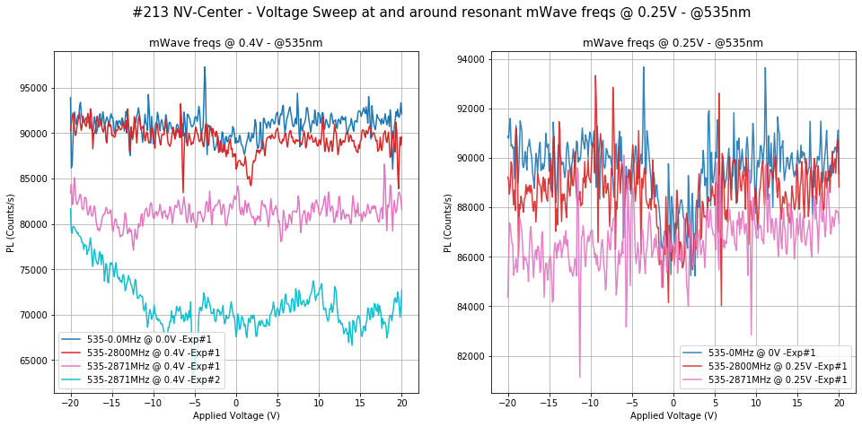

Slide 9
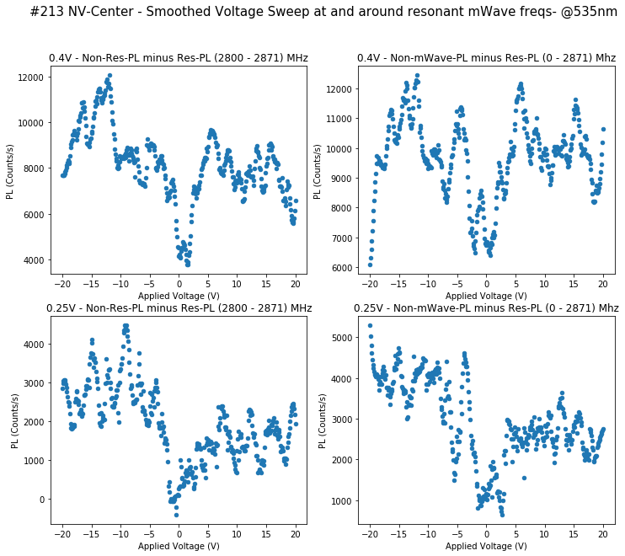
Smoothed Voltage Sweep at & around resonant microwave frequency

Slide 10
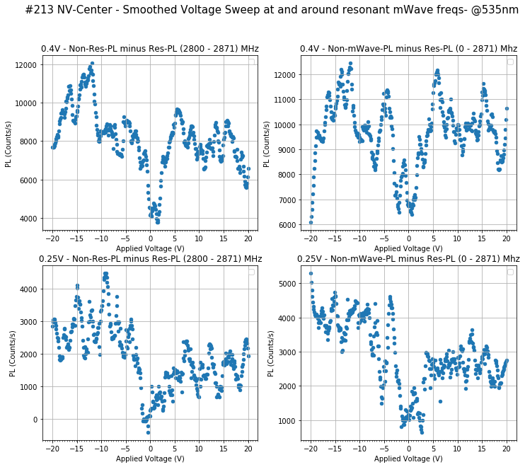
Notice how the peaks are evenly spaced.
Their distance is
3 ± 0.10 V
Is the sample vibrating?
Is this a smoothing artefact?

Slide 11
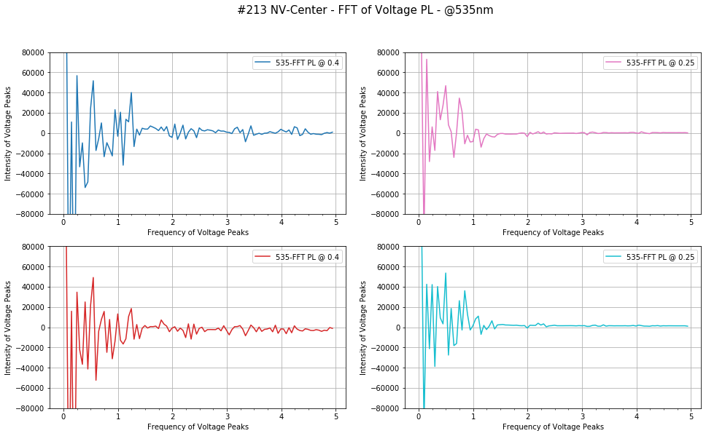
FFT Analysis to determine if there’s periodicity in how PL moves up or down as V sweeps

Slide 12
We’re noticing a sawtooth pattern emerging. Might be a smooth artefact, but perhaps not?

Slide 13
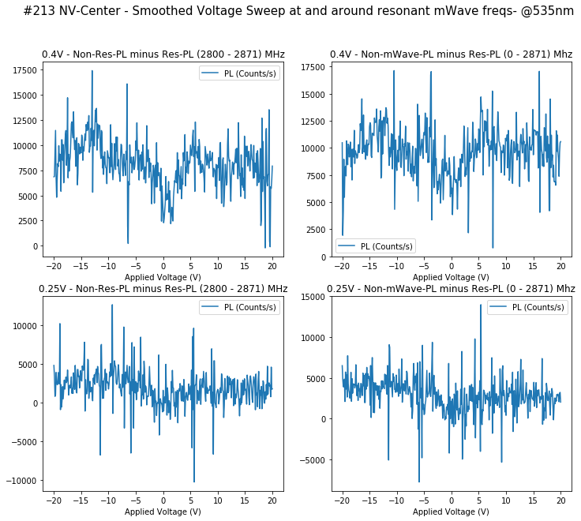
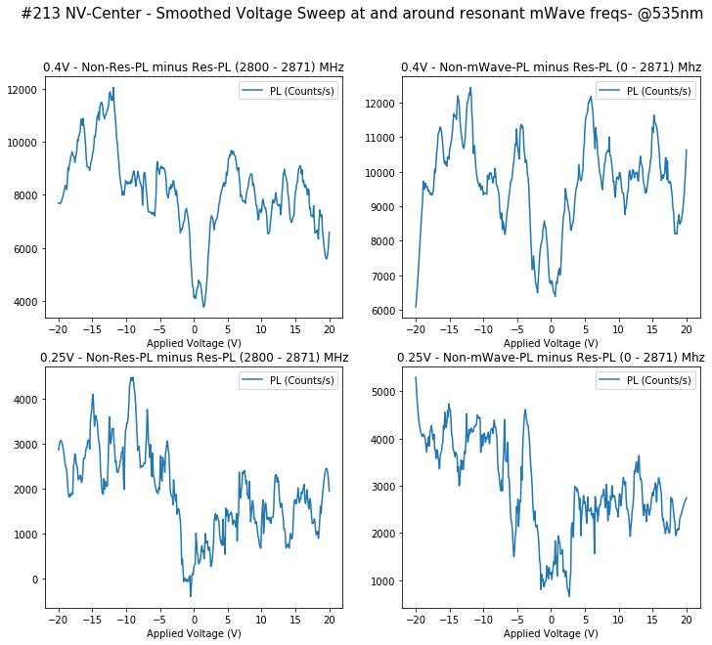
Unfiltered
Filtered 21 – 3 Polynomial
For comparison sake, here’s the noisy data, and filtered using Savitzky–Golay

Slide 14
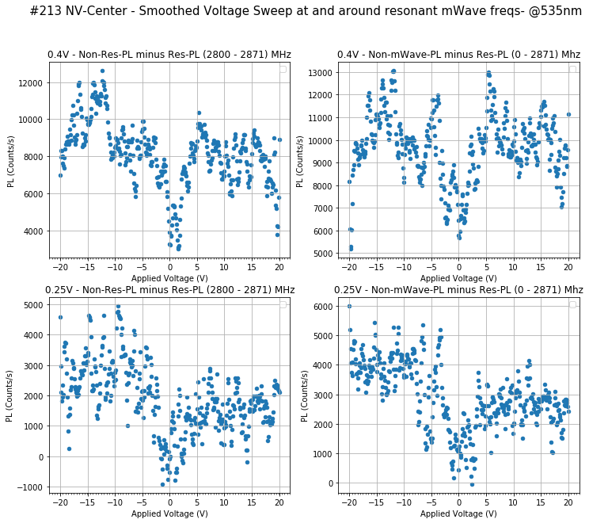
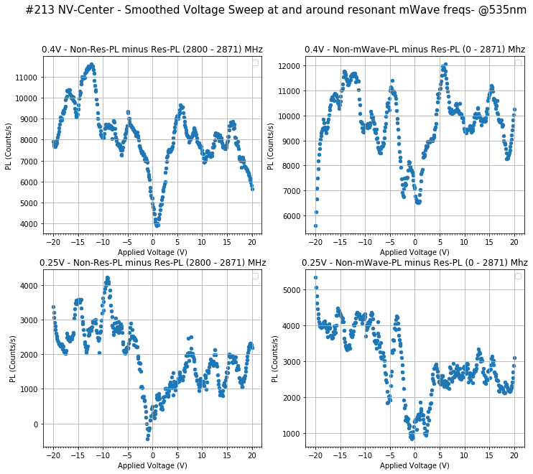
Unfiltered
Filtered 11 Sample Window
– 3 Polynomial
Filtered 31 Sample Window
– 3 Polynomial
Filtered 21 Sample Window
– 3 Polynomial

Slide 15
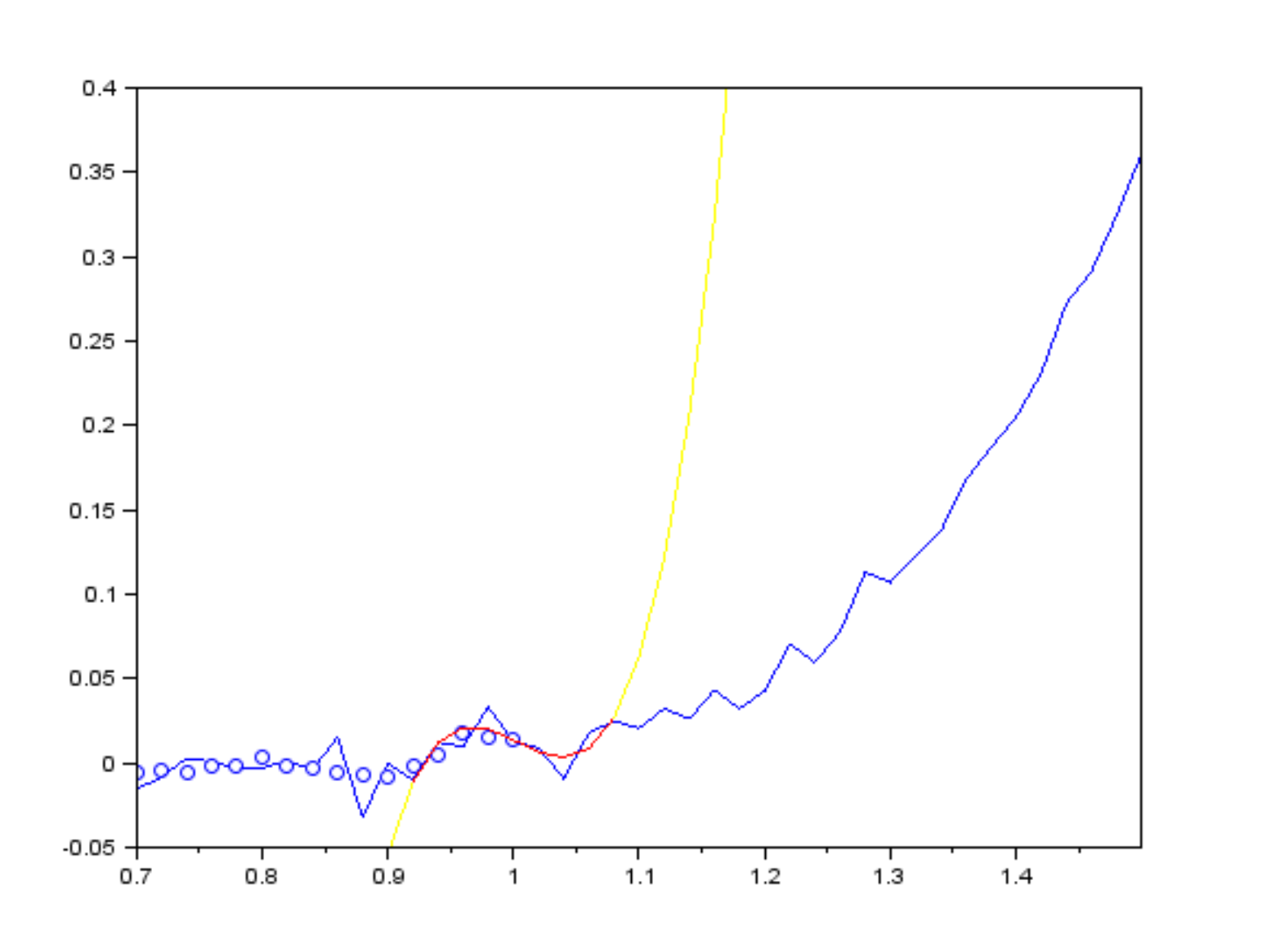
Savitzky–Golay Filter

Slide 16
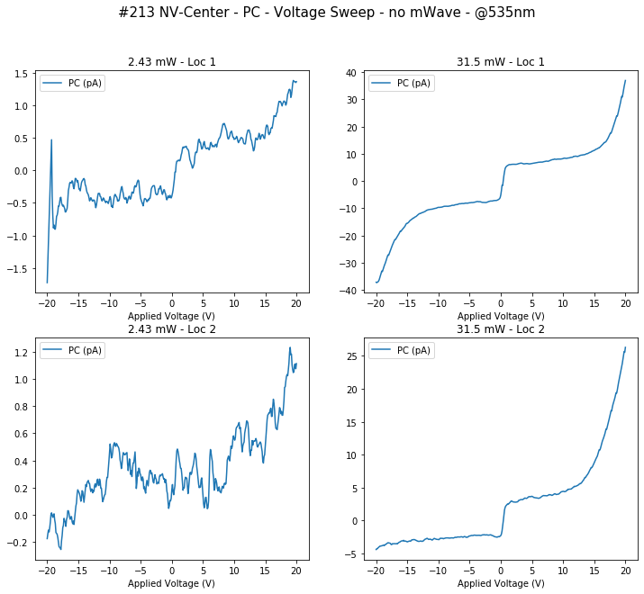

Slide 17
